Slide 1
Special Topic: Beta Beating and Lattice Correction

Slide 2
We know that our general transfer matrix from one point to another in a lattice is
and that our beta function evolves according to.

Slide 3
If we introduce a quadrupole of strength
at the initial point, this modifies our matrix as
These terms are the same

Slide 4
Our distorted beta function becomes
So the distortion will “beat” the periodicity of the cell with the periodicity of twice phase advance. Hence the term “beta beating”.
Solving the problem in a closed ring is a bit more complicated, but the behavior from point to point is the same.

Slide 5
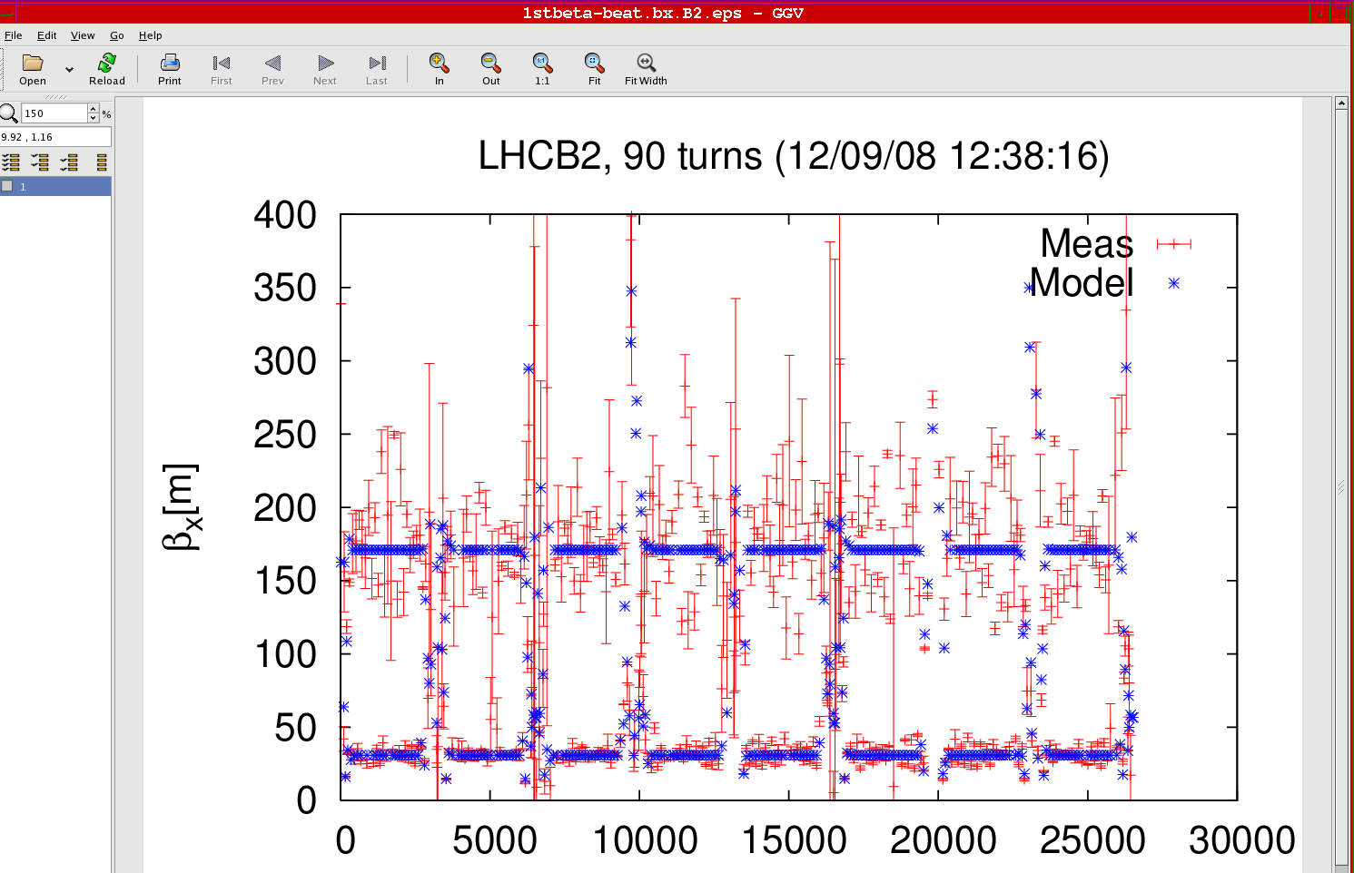
Initial beta-beating in LHC

Slide 6
Correcting Errors
Generally, a dipole will produce a set of x deviations around the ring, and a quadrupole will produce a distorted beta function. So if I have a set of dipole and quadrupole corrector (“trim”) elements, I can write
If I have a set of measured distortions, I can introduce a correction to cancel it. If N=M, then
If N>M, then I must use a bit more sophisticated math to minimize the RMS deviation (there are several techniques).

